Slide 1
Time Value of Money

Slide 2
Decision Dilemma—Take a Lump Sum or Annual Installments
A suburban Chicago couple won the Power-ball.
They had to choose between a single lump sum $104 million, or $312 million paid out over 15 years.
Which do you think is the best choice?
The winning couple opted for the lump sum.
Did they make the right choice?
What basis do we make such an economic comparison?

Slide 3

Why Do We Need to Know?
To make such comparisons, we must be able to compare the value of money at different point in time.

Slide 4
Time Value of Money
Few Important terms
Interest- Interest represents earning power of money. It is a cost to the borrower and an earning to the lender.

Slide 5
Elements of transactions involving interest
Principal amount
Interest rate (%)
Interest period (t)

Slide 6
Types of Interest
Simple
Compound

Slide 7
Methods of Calculating Interest
Simple interest: The practice of charging an interest rate only to an initial sum (principal amount).
In this case interest earned is directly proportional to capital involved in the loan.
If, I= interest earned.
P= Principal amount
i= rate of interest per period
N= number of interest periods (usually years)
Then, I= P * i *N
The total amount the borrower is supposed to pay the lender,
F= P + I => P + PiN =>
F = P(1+ iN)

Slide 8
Methods of Calculating Interest – Simple Interest
Note: When N is not a full year we can calculate simple interest by the following 2 methods.
Ordinary Simple Interest- Year divided into 12 months having 30 days periods or a year is considered to have 360 days (i.e.. 12*30=360).
Exact Simple Interest- A year has exactly calendar no. of days, and N is the fraction of no. of days the loan with its effect in that year.

Slide 9
Methods of Calculating Interest – Simple Interest
Numerical:
Find the future sum of money to be paid to a lender for a loan amount of Rs.1000 for 2 months at the rate of 10%. Use the two methods of interest as mentioned above.

Slide 10
Methods of Calculating Interest – Compound Interest
Compound interest: The practice of charging an interest rate to an initial sum and to any previously accumulated interest that has not been withdrawn.
Total amount to pay, varies drastically when compared to simple interest charged.
F= P . (1 + i)^{n}
P- Principal Amount invested at time 0, F- Future amount,
i- interest rate compounded annually, n- period of deposits

Slide 11

Methods of Calculating Interest – Compound Interest
Alternatively,
What would be the present worth of a certain amount of money which you would want to deposite at the end of n^{th} year?
P = $\frac{F}{\left(1+i\right)n}$
P- Principal Amount invested at time 0, F- Future amount,
i- interest rate compounded annually, n- period of deposits

Slide 12
Methods of Calculating Interest – Compound Interest
Numerical:
Find the future sum of money after 2years, if an amount of Rs. 1000 is deposited now and is charged at an interest rate of 10%, by using Simple and compound interest?

Slide 13
Cash flow diagrams

Slide 14
Cash Flow Diagram:
Cash flow diagrams are the simple representation of income and outlay.
Generally before constructing the diagram it is very common to define the time frame over which cash flow occurs.
The time frame thus forms the horizontal axis which is divided into time periods, often in years.
END-OF-PERIOD convention.

Slide 15
Types of Compound interest
Nominal interest rate
Effective interest rate

Slide 16

Nominal Interest rates
Interest rate are normally calculated on an annual basis.
However interest may be compounded several times in an year quarterly, half yearly or monthly etc. this is nominal interest rate.
Example- Find the future worth at the end of one year for Rs 1000 earning an interest rate of 8% compounded quarterly.

Slide 17
Effective interest rates
It is the ratio of interest charged for 1year to the principal.
This term actually eliminates the confusion over actual interest earned.
Consider the previous example of, 1year loan of Rs.1000 at a nominal interest rate of 8% compounded quarterly.
If compounded biannually at 8%, Future value & effective interest becomes?
Effective interest rate is (1 + r/n)^{n} – 1
Where , r- nominal interest rate
n- number of compounding periods per year

Slide 18
Methods of Calculating Interest – Compound Interest
Numerical:
A finance company charges interest at the rate of 18% compounded monthly. What is the effective interest rate?
If a person has to earn Rs.25000 today, how much he has to invest one year ago, when the investment earned at a nominal rate of 12% compounded monthly?
Find the compound amount of Rs.5000 at 6% for 4,8 and 12 years and compare the results. Does doubling the time double the amount of interest earned?
Find the effective interest rate if the rate of interest is 6% when compounded. (a) Yearly (b) Biannually (iii) Quarterly (iv) Monthly (v) Daily

Slide 19
Economic equivalence
Refers to the fact that a cash flow – whether single or multiple payments , can be converted to an equivalent cash flow at any point in time.
Following are the required data:
Magnitude of the payment
Direction of the payment( income/expense)
Timing of the payment.
Interest rate.

Slide 20
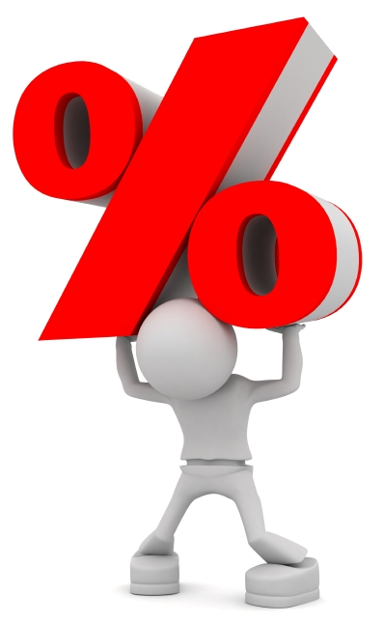
Types of cash flows
Single cash flows
Uniform (equal) series
Linear gradient series

Slide 21
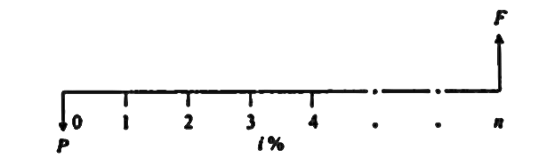
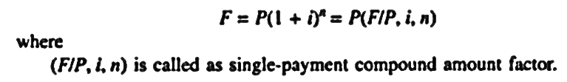
Types of Compound Interest Formulas
1. Single payment compound amount:
Here the objective is to find the single future sum (F) of initial payment P after n period at interest rate i % compounded every period.

Slide 22
Numerical
If you had Rs.2000 now and invested it at 10%, how much would it be worth in 8 years?

Slide 23
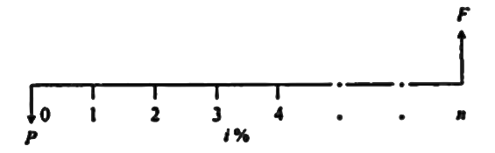
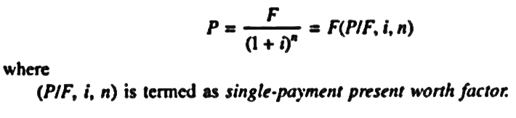
Types of Compound Interest Formulas
2. Single Payment Present Worth Amount:
Here the objective is to find the present worth amount (P) of a single future sum (F) which will be received after n periods at an interest rate of i% compounded at the end of every interest period.

Slide 24
Numerical
Suppose Rs.1000 is to be received in 5 years, at an annual rate of 12%, what is the present worth of this amount?

Slide 25
Suppose you have the alternative of receiving either $18,000 at the end of 5years or P dollars today. Currently, you have no need for the money, so you could deposit the P dollars in a bank that pays 5% interest. What value of P would you deposit today such that you could earn $18,000 at the end of 5years?

Slide 26
Suppose that you are obtaining a loan from your friend in the amount of $25,000 (now) to be repaid in 3 years to cover some of your college expenses. If your friend earns 8% interest on his money, what minimum lump sum payment will be done in three years from now?

Slide 27
You have just purchased 100 shares of Citigroup stock at $60 per share. You will sell the stock when its market price is doubled. If you expect the stock price to increase 20% per year, how long do you anticipate waiting before selling the stock?

Slide 28
Wilson technology , a growing machine shop, wishes to set aside money now to invest over the next 4 years to use to automate its customer service department. The company can earn 10% on a lump sun deposited now, and wishes to withdraw the money in the following increments:
Year1: $25,000 to purchase a computer and database software designed for customer service use.
Year2: $3000 to purchase additional hardware to accommodate anticipated growth in use of the system.
Year3: no expenses
Year4: $5000 to purchase software upgrades.
How much money must be deposited now to cover the anticipated payments over the next 4 years?

Slide 29
A local news paper headline read ’Bo Smith signed for $30M’. A reading of the article revealed that on April 1,2010, Bo Smith, signed a package with the Dallas Rangers. The terms of the contract were $3M immediately, $2.4M per year for the first 5 years, and $3M per year for the next 5 years. If B0’s interest is 8% per year, what would his contract be worth at the time he signs it?

Slide 30
Suppose you have a savings account with your federal credit union. By looking at the account, you learned the interest rate in each period during the last 5years was as shown in the fig. Calculate the balance at the end of 5years.

Slide 31
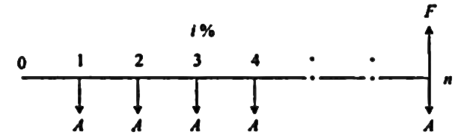
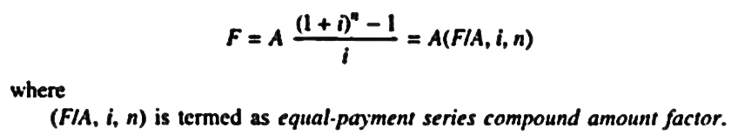
Types of Compound Interest Formulas
3. Equal Payment Series Compound Amount:
Here the objective is to find the future worth of n equal payments which are made at the end of every interest period till the end of nth interest period at an interest rate of i % compounded at the end of each interest period.

Slide 32
Suppose you make an annual contribution of Rs.3000 to your savings account at the end of each year for 10years, if your account earns 7% interest annually, how much can be withdrawn at the end of 10 years?

Slide 33
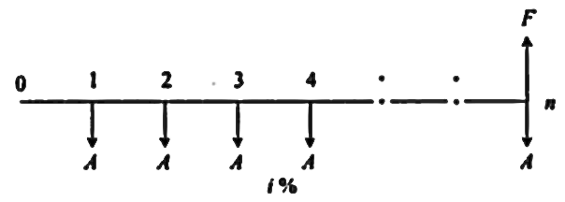
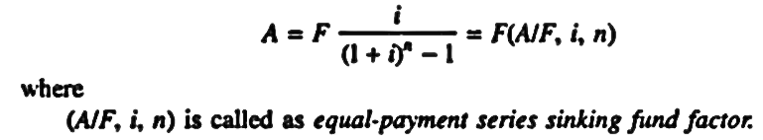
Types of Compound Interest Formulas
4. Equal Payment Series Sinking Fund:
Here the objective is to find the equal amount (A) that should be deposited at the end of every interest period for n period to realize a future sum (F) at the end of nth period at an interest rate of i %.

Slide 34
A person estimates an expenditure of Rs.10,00,000 for about 8years from now. He plans to deposit an equal amount at the end of every year for the next 8years at 12% compounded annually. Find the equivalent amount that must be deposited at the end of every year for the next 8years.

Slide 35
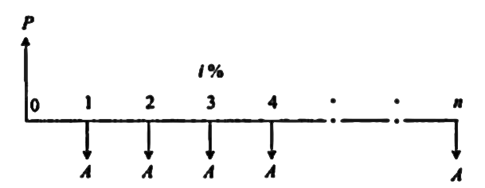
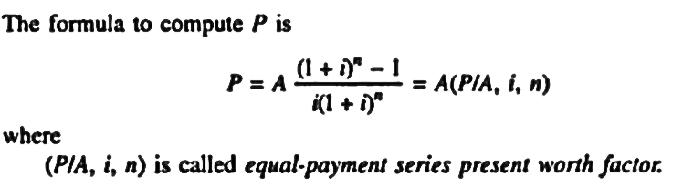
Types of Compound Interest Formulas
5. Equal Payment Series Present Worth:
Objective is to find present the worth of an equal payment made at end of every interest period for n periods.

Slide 36
A person wants to give scholarships to poor students, which is Rs.25,000 every year. He wants to deposit in the bank, which makes him receive the required amount for the next 20years. The reserve is assumed to grow annually at the rate of 9%. Find the single payment that must be made now as the reserve amount?

Slide 37
A company has borrowed Rs.2,50,000 to purchase a lab equipment. The loan carries an interest rate of 8% per year & is to be repaid in equal installments over next 6 years. Compute the amount of equal annual repayment.

Slide 38
A person plans to have a retirement policy which will give him a return when he reaches an age of 50.For this person whose age is 35years now has to make annual premium payment of Rs.19760 till he reaches an age of 49.If the interest rate is 8%, what is the lump sum he is getting on the maturity of this policy?

Slide 39
Suppose that you have savings plan covering the next 10years, according to which you put aside $600 today , $800 at the end of every year for the next 5years, and $2000 at the end of each year for the remaining 5years. As a part of the plan, you expect to withdraw $300 at the end of every year for the first 3years, and $350 thereafter till the 10th year.
i=12%
draw CFD
Find the amount accumulated at the end of 10years.

Slide 40
How much money will be accumulated in 25years if Rs.800 is deposited at the end of 2nd year from now,
Rs.2400, 6years from now
Rs.3300, 8years from now?
all at an interest rate of 18% PA. Find the equivalent annual worth for the time period of 25years.

Slide 41
You have just purchased 100 shares of General Electric stock at $60 per share. You will sell the stock when its market price has doubled. If you expect the stock price to increase 20% per year, how long do you anticipate waiting before selling the stock

Slide 42
A clever industrial engineer found that by spending $16,000 now to reconfigure the production line and reprogram two of the robotic arms, the cost will go down to $58,000 next year and $52,000 in years 2 through 5. Using an interest rate of 10% per year, determine ( a) the equivalent annual cost of the manufacturing operations.

Slide 43
You plan to retire 33years from now. You expect that you will live 27years after retiring. You want to have enough money upon reaching retirement age to withdraw Rs.1,80,000 from the account at the end of each year you expect to live, and yet still have Rs.25,00,000 left in the account at the time of your expected death. You plan to accumulate the retirement fund by making equal annual deposits at the end of each year for the next 33 years. You expect that you will be able to earn 12% per year on your deposits. however, you only expect to earn 6% per year on your investment after you retire since you will choose to place the money in less risky investments. What equal annual deposits must you make each year to reach your retirement goal?

Slide 44
Gradient series
A uniform gradient is a cash flow series which either increases or decreases uniformly.
The amount of increase or decrease is the gradient.
The value of G (gradient) may be positive or negative.

Slide 45

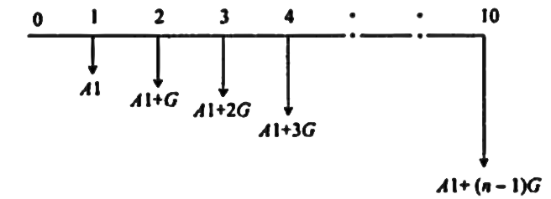
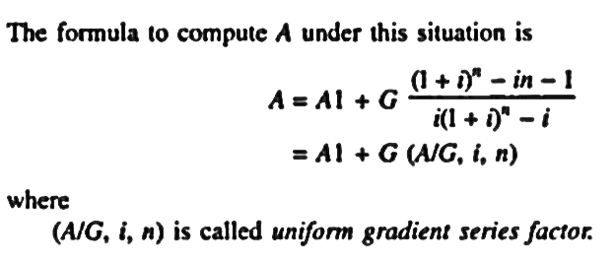
Uniform Gradient series annual equivalent amount (A/G,i,n)
The objective of this type of investment is to find the annual equivalent mode of a certain series with an amount A, at the end of 1st year and with an equivalent increment G at the end of each of the following (n-1) years with the interest rate i% compounded annually.

Slide 46
Problems
Mr. A has 10 years of service before he retires. He now plans to deposit Rs. 25000 at the end of first year and thereafter an annual increase of Rs.500 for the remaining 9 years. If he can expect a return of 10%, find the future amount at the end of 10th year.
A new piece of material handling equipment costs Rs.20000 and is expected to save Rs.7500 in the first year of operation. Maintenance and operating costs are expected to reduce the net savings by Rs.500 per year for each additional year of operation until the equipment is worn out at the end of 8 years. Determine the net present worth of the machine at an interest rate of 12%.

Slide 47
It is estimated that the maintenance cost on a new car will be $40 the first year. Each subsequent year, this cost is expected to increase by $10. How much would you need to set aside when you bought a new car to pay all future maintenance costs if you planned to keep the vehicle for 7 years? Assume interest is 5%per annum.

Slide 48
A man is purchasing a small garden tractor. There will be no maintenance cost during the first 2 years because the tractor is sold with 2 years free maintenance. For the third year, the maintenance is estimated at $20. In subsequent years the maintenance cost will increase by $20 per year (i.e., fourth-year maintenance will be $40, fifth-year $60, etc.). How much would need to be set aside now at 8% interest to pay the maintenance costs on the tractor for the first 6 years of ownership?

Slide 49
A textile mill has just purchased a lift truck that has a useful life of 5years. The engineer estimates that maintenance costs for the truck during the first year will be Rs.1000. as the truck ages , maintenance costs are expected to increase at a rate of Rs250 per year over the remaining life. Assume that the maintenance costs occur at the end of each year. The firm wants to set up a maintenance account that earns 12% annual interest. All future maintenance expenses will be paid out of this account. How much does the firm have to deposit in the account now?

Slide 50
John and Barbara have just opened two savings accounts at their credit union. The accounts earn 10% annual interest. John wants to deposit $1000 in his account at the end of the first year from now and increase this amount by $300 for each of the next five years. Barbara wants to deposit an equal annual deposit so that the two accounts will have equal amount each year for the next six years. What should be the size of Barbara’s annual deposit so that the two accounts will have equal balances at the end of six years?

Slide 51
Suppose that you make a series of annual deposits into a bank account that pays 10% interest. The initial deposit at the end of 1st year from now is Rs.1,200.The deposit amount declines by Rs.200 in each of the next 4years. How much would you have immediately after 5th deposit?

Slide 52
Wonder la entertainment company is evaluating an investment that will provide the following returns at each of the following years. Wonder la believes that it should earn an annual rate of 9% on this investment. How much can it pay for this investment now?
YEAR | Returns(Rs)
2 | 12,500
3 | 10,000
4 | 7,500
5 | 5,000
6 | 2,500
7 | 1,200
8 | 12,500

Slide 53
Nominal & effective interest rate
Effective interest rate is given by:
i(eff)= (1+r/ck)^c – 1
Where: r – nominal interest rate
c – no. of interest periods per payment period
k – no. of payment periods per year
Where: ck is equal to M
i.e. M=ck
Where M= No of compounding periods

Slide 54
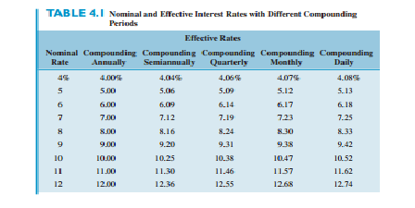

Slide 55
Problems
Suppose that you make quarterly payments in a savings account that earns 9% interest compounded monthly. Compute the effective interest rate per quarter.

Slide 56
Find the effective interest rate of per quarter payments at a nominal rate of 8% compounded
quarterly
monthly
Weekly
Daily

Slide 57
Suppose you make equal quarterly deposits of $1,500 into a fund that pays interest at a rate of 6% compounded monthly. Find the balance at the end of year2.

Slide 58
Suppose you make $500 monthly deposits to a tax deferred retirement plan that pays interest at a rate of 10% compounded quarterly, compute the balance at the end of 10years.

Slide 59
A series of monthly cash flows is deposited into an account that earns 12% nominal interest compounded monthly. Each monthly deposit is equal to $2100. the first monthly deposit occurred on june1,1998 and the last monthly deposit will be on January 1, 2005. the account also has equivalent quarterly withdrawals from it. The first quarterly withdrawal is equal to $5000 and occurred on October 1, 1998. the last $5000 withdrawal will occur on january1,2005. how much remains in the account after the last withdrawal?

Slide 60
A person deposits $5,000 for the three years starting from now in a savings account that pays 6% interest compounded monthly. At the end of 6th year, he deposits $4000.Two years after the $4000 deposit, he makes another 2 equal deposits of $2,500 semi-annually. Six years after the previous deposit, half of the accumulated fund is transferred to a fund that pays 8% interest compounded quarterly. How much money will be accumulated in each account after one year of this transfer?

Slide 61
The Scott and White Health Plan (SWHP) has purchased a robotized prescription fulfilment system for faster and more accurate delivery to patients with stable, pill-form medication for chronic health problems, such as diabetes, thyroid, and high blood pressure.
Assume this high volume system costs $3 million to install and an estimated $2,00,000 per year for all materials, operating, personnel, and maintenance costs. The expected life is 10 years.
SWHP biomedical engineer wants to estimate the total revenue requirement for each 6-month period that is necessary to recover the investment, interest, and annual costs. Find this semi-annual ‘A’ value, if capital funds are evaluated at 8% per year, compounded semi-annually.

Slide 62
Heyden Motion Solutions ordered $7 million worth of seamless tubes for its drill collars from the Timken Company of Canton, Ohio. (A drill collar is the heavy tubular connection between a drill pipe and a drill bit.) At 12% per year, compounded semi-annually, what is the equivalent uniform cost per semi-annual period over a 5-year period?

Slide 63
Loadstar Sensors is a company that makes load force sensors based on capacitive sensing technology. The company wants to have $28 million for a plant expansion 4 years from now. If the company has already set aside $12 million in an investment account for the expansion now, how much more must the company add to the account next year (i.e., 1 year from now) so that it will have the $28 million 4 years from now? The account earns interest at 12% per year, compounded quarterly.

Slide 64
A structural engineering consulting company is examining its cash flow requirements for the next 7 years. The company expects to replace office machines and computer equipment at various times over the 7-year planning period. Specifically, the company expects to spend $21,000 for two years from now, $24,000 during the 3rd year, which decreases by $2000 from 4 through 6 and $30,000 during the 7th year. What is the present worth of the planned expenditures at an interest rate of 10% per year, compounded semi-annually?

